Slide 1
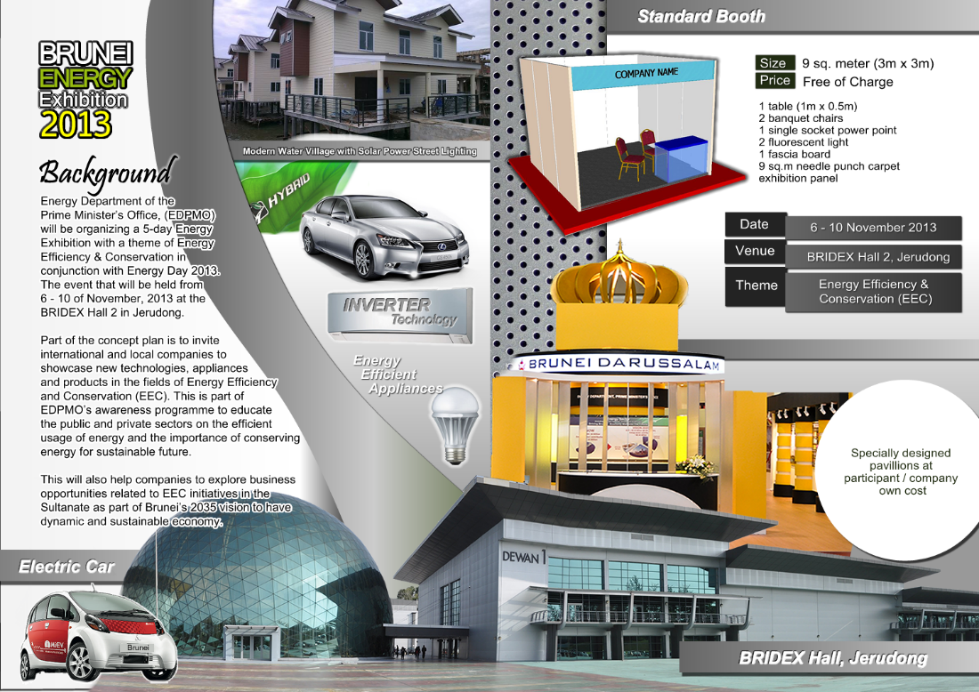




45th Meeting of the APEC Expert Group on Energy Efficiency & Conservation (EGEE&C 45)
Singapore: 25-26 March, 2015
ECONOMY UPDATES
Brunei Darussalam
Presented by
Abdul Salam Haji Abdul Wahab
Head of Sustainable Energy Division
Energy Department Prime Minister’s Office
Sustainable Energy Division,
Energy Department,
Prime Minister’s Office
Brunei Darussalam

Slide 2

ENERGY EFFICIENCY & CONSERVATION
ENERGY EFFICIENCY & CONSERVATION
Brunei Energy White Paper was launched on the 24/03/2014 and EEC falls under strategic goal 2
  Key Performance Indicator (KPI) 5:
    To reduce the energy intensity to 45% by 2035 through Energy Efficiency & Conservations (EEC) initiatives.
Key Initiatives need to be realized to meet the target:
  To reduce the Total Energy Consumption on fossil fuel supply for inland energy use down to 63% by 2035.
  Develop and implement energy efficiency & conservation policies and laws.
  Promoting and developing all plans and programs related to energy efficiency & conservation (EEC) nationwide.
  Deployment of Renewable Energy (RE).
Key Enabler
  IMPLEMENTATION OF A COMPREHENSIVE SET OF SUPPORTIVE POLICY AND REGULATORY FRAMEWORKS.
    Policy 1 – Electricity Tariff Reform
    Policy 2 – Appliance Standards & Labeling
    Policy 3 – EEC Building Guidelines
    Policy 4 – Energy Management
    Policy 5 – Fuel Economy Regulation
    Policy 6 – Financial Incentives
    Policy 7 – Awareness Raising
Notes:
■ Priority Initiative 1: Introduce Renewable Energy Policy and Regulatory Frameworks
– Establish renewable energy policies and regulatory frameworks.
– Introduce support mechanisms to stimulate private sector investments.
– Establish clear market and grid access rules and procedures.
■ Priority Initiative 2: Scale-up Market Deployment of Solar PV and Promote Waste-to-Energy
Technologies
– Establish grid-connected solar PV development targets taking into account variable nature
of the solar energy.
– Adopt the most efficient and state-of-art waste-to-energy technologies taking into account
source of waste generation, collection, sorting and recycling systems.
– Create policy framework for public private partnership to accelerate the implementation of
solar PV and waste-to-energy projects.
■ Priority Initiative 3: Raise Awareness and Promote Human Capacity Development
– Carry out public awareness programs through roadshows, forums, exhibitions to increase
the awareness concerning renewable energy.
– To utilise Tenaga Suria Brunei (TSB) as a training facility for best practice project development
to stimulate replication and scale up solar PV investments.
– Strengthen higher learning institutions and industry stakeholders in promoting renewable
energy education, capacity building and entrepreneurships.
■ Priority Initiative 4: Support Research, Development and Demonstration (RD&D) and Technology
Transfer
– Promote RD&D of RE Technologies that have potential for commercialisation in the country
and for exports.
– Promote transfer of technologies and facilitate linkage between international research
institutions and private companies and local entities.

Slide 3
LOCAL ACTIVITIES
IMPLEMENTATION OF STANDARDS AND LABELING ORDER IN BRUNEI DARUSSALAM.
  Background:-
  Objective: To restrict the importation and sales of the inefficient electrical appliance & product (ie, air conditioning) into the country and concurrently to educate and encourage people to choose a more energy-efficient electrical appliances & products.
  Status & way forward:-
  The Minimum Energy Performance Standards (MEPS) for split unit is 2.9 (capacity up to 7.1 kW) and window unit is set at 2.6.
  To work on energy label rating and finalize energy label.
  To discuss with MOF on the potential incentives that could be provided by the government to expedite market transformation.
  To organize a series of public consultations/ or roadshows once the Order has been endorsed by the AGC.
  The Order is expected to be implemented by Q1, 2016.
  Challenges:-
  To establish coherent and effective incentive mechanism such as import duty and excise duty exemption for all energy efficient products and appliances.
  Establishment of enforcement unit in order to prevent the smuggling of inefficient electrical goods via the border.

Slide 4
LOCAL ACTIVITIES
      EEC BUILDING GUIDELINES FOR NON-RESIDENTIAL SECTOR
      Background
      A collaboration work with the Ministry of Development via the ABCi and the DME.
      This guideline is mandatory to all government buildings and voluntary to all commercial buildings but later become mandatory as and when it is notified by the government authorities.
      Milestone & Timeline
High level meeting
(Project update to steering committee)
1st JWC meeting
2nd JWC meeting
4rd JWC meeting
6th JWC meeting
Endorsement by the Ministers
Dec 12, 2012
Jan 30, 2014
Apr 17, 2014
June 25, 2014
July - Aug, 2014
Nov, 2014
PROJECT
KICK-OFF
LAUNCHING
(Nov - Dec, 2014)
Sept 8, 2012
Dec 21, 2013
Jan 20-25, 2014
May 22, 2014
June- July, 2014
Aug - Sept, 2014
High level meeting
(Project update to steering committee)
AJEEP Program - Scheme 2 Workshop in Brunei Darussalam
5th JWC meeting
Completion of data compilation
High level meeting
(Project update to steering committee)
      Status & way forward:-
      The guideline has been circulated to all ministerial buildings in Q4, 2014.
      To conduct energy consumption survey for buildings in government, commercial & industrial sectors.
  Challenges:-
  An absent of Energy Manager for each building to conduct energy audit and prepare recommendations on how to reduce energy consumption.
  Difficult to get the real & credible set of data on energy consumption for buildings in Brunei Darussalam.

Slide 5
TRANSPORTATION SECTOR
(Programmes & Initiatives)
3. FUEL ECONOMY REGULATION
  Collaboration work with the Ministry of Communication.
Policy Implementation Target:-
To set 17.2 km/l by 2020 and 21.3 km/l by 2025.
Hybrid car, Electric Vehicle (EV) & Fuel Efficient Vehicles (FEV) shall be introduced as well as the deployment of public transportation.
Challenges
  Need to provide sufficient transition time for consumers to update its fleet;
  Automobile manufacturers may need time to prepare for new vehicles that comply with the new regulations.
    4. INTRODUCTION OF HYBRID CAR & EVs & FEVs
      Objectives:-
        Part of EEC initiative to reduce the energy intensity by 45% by 2035.
        To achieve towards a cleaner, greener and more sustainable transportation system.
        Challenges:-
          To provide infrastructure for electric vehicles (charging stations) which are very costly.
          To establish coherent and effective incentive mechanism such as import duty and excise duty exemption for all green vehicles.

Slide 6
UPCOMING LOCAL ACTIVITY
5. DEVELOPMENT OF ENERGY MANAGEMENT POLICY.
  Background:-
  Brunei Darussalam is considering adopting an Energy Management System that is compatible with the ISO 50001.
  Building owners will be encouraged to introduce management systems that include equipment to monitor energy consumption such as the Building Automation Systems (BAS), Controllers (i.e. demand controllers) and Building Energy Management Systems (BEMS).
  EDPMO will be preparing a paperwork for the establishment of the Energy Manager for all buildings belong to government ministries in Brunei Darussalam.
  Heads-up:-
  In order to demonstrate the effectiveness of energy management systems, a number of government, commercial and industrial facilities should be selected to participate in an energy management pilot program in line with ISO 50001 criteria.
  In support of the energy management law, a sufficient number of qualified external auditors should be trained to conduct monitoring and verification exercises to ensure compliance.
  Seek assistant from international experts (ECCJ, Japan, ACE, etc).
  The policy is expected to be implemented by 2017.

Slide 7
UPCOMING LOCAL ACTIVITY
NATIONAL ENERGY CONSUMPTION SURVEY FOR ALL SECTORS IN BRUNEI DARUSSALAM.
  Background:-
    The first comprehensive energy consumption survey which cover the whole 4 sectors (residential, commercial, government & industrial sectors) in Brunei Darussalam.
    International cooperation framework between the Brunei Government with the Economic Research Institute for ASEAN and East Asia (ERIA) & the Institute of Energy Economics, Japan (IEEJ).
  Objectives:-
  To quantify and characterize energy end use and improve the basis for government policy planning and implementation.
  To provide new insights on the energy consumption and eventually identify which energy efficiency policy or measure will make the greatest impact.
  Heads-up:-
  Design of questionnaire and test interviews .
  Recruit and conduct training for interviewers.
  Data Analysis and Validation and report writing.
  Dissemination workshop.

Slide 8
THANK YOU
Abdul Salam Haji Abdul Wahab
salam.wahab@energy.gov.bn

