Slide 1
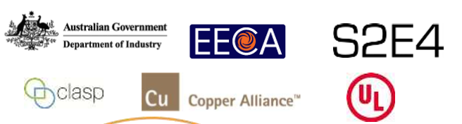
Establishing an APEC MV&E Network
45th Meeting of the APEC Expert Group on Energy Efficiency & Conservation
Nicole Kearney
Senior Associate, CLASP
March 25, 2015
Singapore

Slide 2
Session Overview
Overview of completed APEC funded MVE project and deliverables
Outcomes of MVE Workshop held in Beijing, October 2014
Next steps for establishing an APEC MVE Network
Discussion

Slide 3
APEC Funded MVE Project Overview
EWG12 2013A: Catalysing Monitoring, Verification & Enforcement Best Practices Exchange and Building Compliance Capacity in the APEC Region
Project Time Period:
  December 2013 – December 2014
  Status – completed
Project supported by:
  Australian Department of Industry
  New Zealand Energy Efficiency and Conservation Authority
  CLASP
  Copper Alliance
  Underwriter Laboratory
Objective: Identify best practices for verification testing and create a MV&E Network in the Asia-Pacific region to facilitate continuous information sharing and partnership development

Slide 4
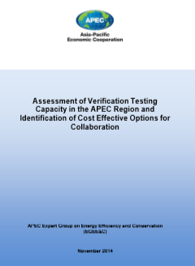
Completed Project Objectives
Conducted of a survey of existing and planned test laboratories in APEC countries able to test products of interest to APEC economies
Prepared a report on: “Assessment of Verification Testing Capacity in the APEC Region and Identification of Cost Effective Options for Collaboration”
Organised a Compliance Best Practices workshop held in Beijing 24 October 2014, with economy presentations by Thailand and New Zealand, and a roundtable discussion of national MV&E activities

Slide 5
Survey of Market Compliance Mechanisms for EE Programs in APEC Economies
Compiled information on MV&E processes used to ensure compliance in S&L programs in APEC economies.
Findings based on a survey of 18 APEC economies and other discussions within the region.
Recommendations included:
  Regional initiatives / network to improve transfer of knowledge
  Awareness raising and communication
  Developing Operational Guidelines for MVE
  Access to Test Laboratories
  Industry Engagement

Slide 6
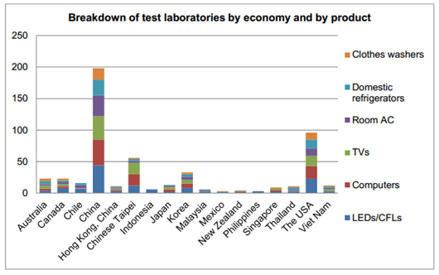
Assessment of Testing Capacity in APEC
Study to identify testing laboratories in APEC region with capacity to test energy efficiency metrics for:
  Lighting (CFLs, LEDs), Room ACs, TVs, Computers, Domestic Refrigerators and Clothes Washers
Around 250 laboratories identified, mainly in economies with manufacturing capacity
Collaboration on testing
enables more cost-
effective compliance
activity
Bilateral agreement between Vietnamese authorities and a Thai laboratory to carry out certified testing on domestic refrigerators
Notes:
To compensate for insufficient testing capacity, the assessment recommends that small economies leverage test facilities from neighbouring economies. For example, due to Vietnam’s constrained laboratory capacity to test domestic refrigerators, a laboratory in Thailand has been officially designated by the Vietnamese authorities to certify this product category.

Slide 7
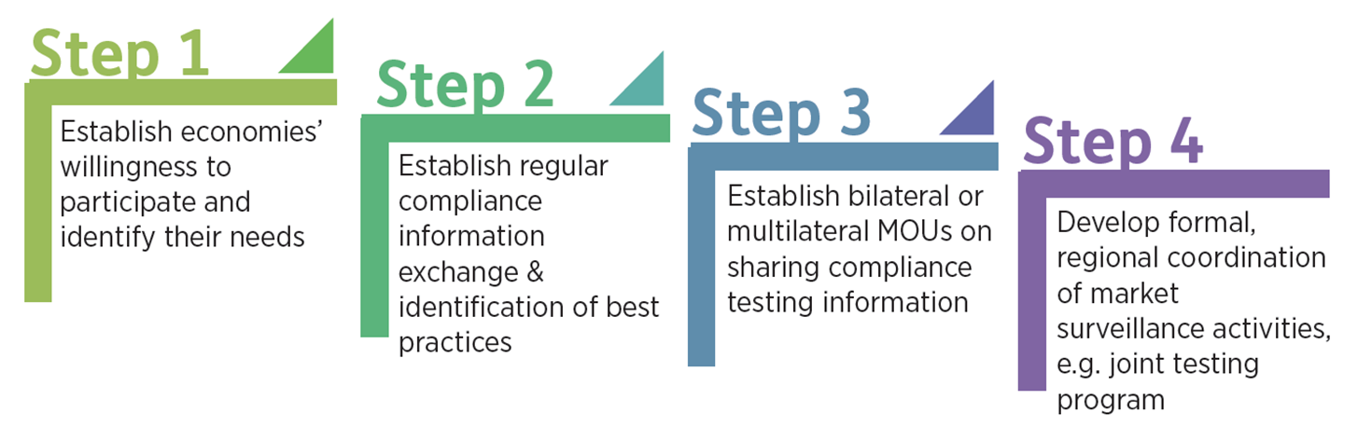
Outcomes of 2015 Beijing MV&E Workshop
Agreed on benefits of establishing an APEC MV&E Network
  Strategic regional, cost-effective approach to reduce non-compliance
Discussed how to establish a network for MV&E authorities (government to government collaboration)
  Focus on compliance intelligence-sharing and peer learning
  Taking a step by step approach towards regional collaboration and coordination
  Meetings alongside APEC EGEE&C or other fora
Developed and discussed the draft Beijing MV&E Regional Collaboration Guiding Principles

Slide 8
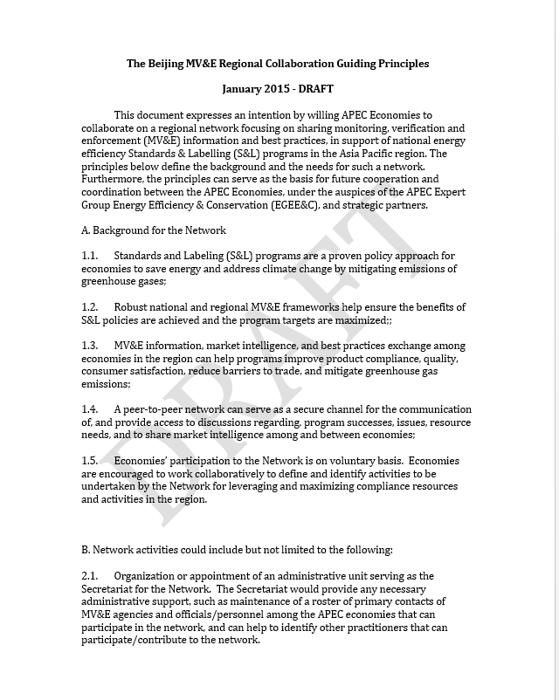
Goal for today’s session…
Agree on principles set out in the draft APEC MV&E Regional Collaboration Guiding Principals
  Hold regular meetings twice a year to facilitate transfer of knowledge:
    Better communication between economies
    Sharing experiences and discussing challenges
    Increase data sharing
    Sharing test plans and results
  Participation is on a voluntary basis
Seek nominations for the Chair and Secretariat
Seek volunteers to join the network
Discuss potential pilot projects

Slide 9
For consideration…
Guiding Principles not final – comments and amendments welcome!
A successful network requires APEC economy leadership and participation
Minor investment required from APEC economies:
  In-kind staff time contribution
  Motivation to engage and share information with other economies
Potential support available from:
  Different funding streams (APEC, APEC-CAST, etc)
  APEC EGEE&C observers (ICA, CLASP, UL)
Short term goals:
  Regular engagement between several volunteer MVE authorities to share information
  Launch pilot projects to put Guiding Principles into practice
  Leverage existing projects focused on harmonisation
Long term goals:
  Regular engagement between many MVE authorities to share information
  Regional repository of information / database
  Regular sharing of test plans and results, coordinated testing activities
  Formal APEC group (?)

Slide 10
Discussion
What do economies want from a Network / regular meetings?
  Information and best practice exchange
  Sharing of test plans and results
  Coordinated product-focused pilot projects
  Creation of a regional product test registry
Any challenges for joining a Network – what do you need to overcome these?
Upcoming opportunities for meetings?
Opportunities for pilot projects?
What formalities needed to join a Network?
Do any economies volunteer their participation in regular MV&E focused-meetings?
Nominations for Chair?

Slide 11
Next steps
Send comments on Draft Guiding Principles to nkearney@clasponline.org by April 15
  This can be a living document, evolving as needed by the Network
Agree Chair of the Network
Agree participation in the Network
Agree on next meeting
  Alongside next APEC EGEE&C meeting
  Identify opportunities to meet beforehand
Organise first APEC MV&E Network meeting!

Slide 12
Thank you!
Please contact Nicole Kearney at nkearney@clasponline.org with any questions or comments

